Slide 1

Coming soon to Hazleton Area High School (HAAS, HACC, HAHS)!

Slide 2
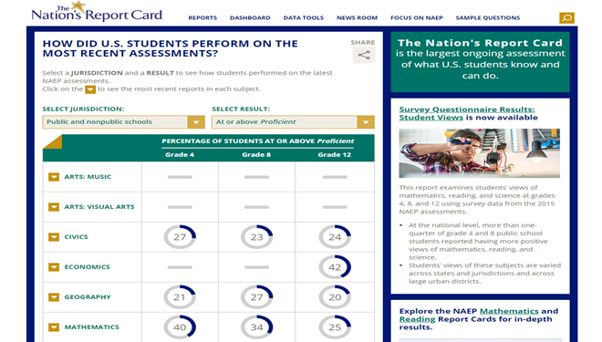
What is the Nation’s Report Card?
A program that measures student achievement in major subject areas across the nation at grades 4, 8, and 12.
It is also known as NAEP, which stands for the National Assessment of Educational Progress.
Our school has been selected to represent schools across the country.
https://nationsreportcard.gov/

Slide 3

What is included on the NAEP test?
Seniors will take a mathematics, reading, or science assessment on a tablet.
  Each student will take one subject only.
The tablets include a keyboard, stylus, and earbuds. NAEP representatives will bring all equipment, and will administer the assessment.

Slide 4
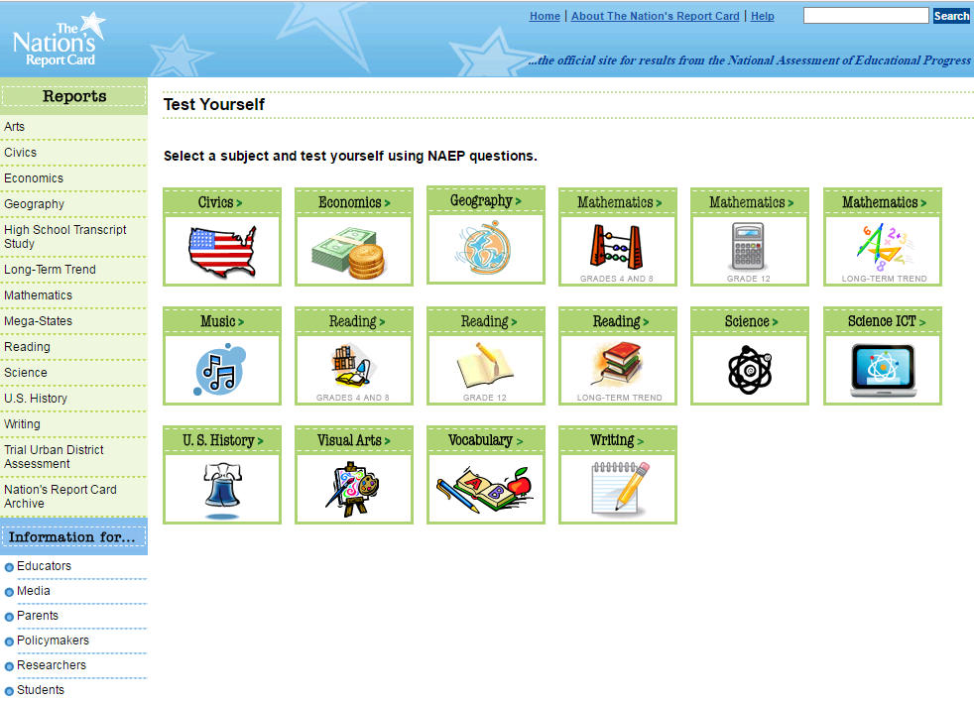
What is included on the NAEP test?
Questions are multiple-choice, short answer, or essay.
Questions about how teachers teach, students’ educational experiences, and other information.
Sample questions are available online.
https://nationsreportcard.gov/testyourself.aspx

Slide 5
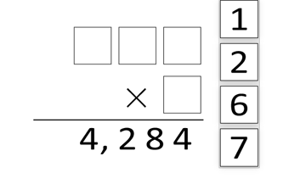
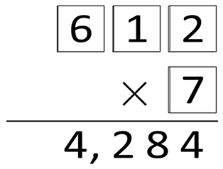
Sample Mathematics Question
Drag each of the digits 1, 2, 6, and 7 into the boxes to make the following multiplication problem correct.
Use each digit only once.
79% of students answered correctly during the 2017 assessment.
Correct Response

Slide 6
Sample Reading Excerpt
“I don't mean to put a damper on things. I just mean we ought to treat fun reverently. It is a mystery. It cannot be caught like a virus. It cannot be trapped like an animal. The god of mirth is paying us back for all those years of thinking fun was everywhere by refusing to come to our party. I don't want to blaspheme fun anymore. When fun comes in on little dancing feet, you probably won't be expecting it. In fact, I bet it comes when you're doing your duty, your job, or your work. It may even come on a Tuesday.”
FUN by Suzanne Britt Jordan
From The New York Times, used with permission.

Slide 7
Sample Reading Question
Explain what the author means when she says, "Fun is a rare jewel."
She means that fun is not something that exists everywhere in everything. Rare jewels are precious and cherished, not something found in common, everyday life. She is saying that fun is just like that, that it should be precious and savored when it becomes available.
78% of students wrote an acceptable response to this question during the 2013 assessment.

Slide 8
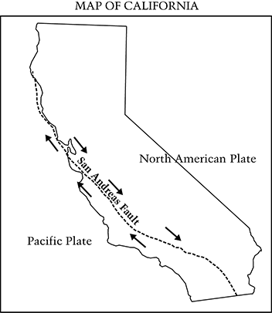
Sample Science Question
The diagram below shows the movement of the Pacific and North American plates along the San Andreas fault located in California.
A
One plate slowly pushes the other plate up.
B
A trench is created as one plate slides under the other plate.
Portions of the plates get stuck and then suddenly loosen and move.
C
D
One plate pushes hard enough to reverse the motion of the other plate.
25% of students selected C, the correct answer to this question during the 2011 assessment.
Why do earthquakes occur near the San Andreas fault?

Slide 9
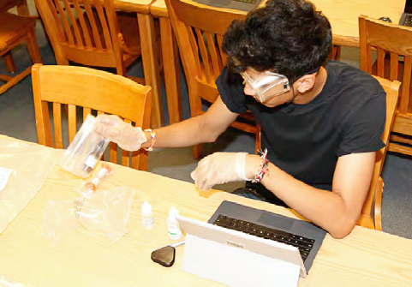
Hands-on Science Tasks
Students selected for the science assessment will use a kit to perform experiments and will use tablets to enter their observations.

Slide 10
How do I prepare my students for NAEP?
There’s no need for students to study or prepare.
Students should be encouraged to try their best to answer each question. NAEP just wants to know how much seniors know about the subject area.
Scores will be anonymous and will not affect grades or academic records in any way.
Scores will be combined with other students’ scores to show what seniors know about the subject area across the nation.

Slide 11

What should students expect?
Testing takes place on February 26, 2019, and will take about 120 minutes.
We will call students out of class that day.
Students will receive a hall pass telling them where to report.

Slide 12

Student participation is important
Thanks to you, our students received a great education here at Hazleton Area High School
Encourage our students to do their best because they represent seniors all across the United States.
It’s a great way to do something good and contribute to the future of education.

Slide 13
Principals play an important role too
Principals will be given a survey to complete about our school’s…
  Demographic characteristics
  Course requirements
  Teachers
  Teacher training on new content and teaching approaches
This information, along with the student assessment, gives a broad picture of how students are taught across the nation.

Slide 14
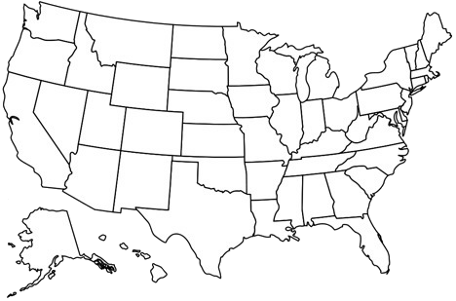
NAEP is important
Important decisions about education are made using the results of these tests.
NAEP results are used by the media and policymakers to judge the quality of our nation’s high schools.
Students can contribute to improving the quality of education for every student in the United States.

Slide 15



Find out more
Visit NAEP: http://nces.ed.gov/nationsreportcard/students
Follow NAEP:

Slide 16
A word from your peers!
Here’s a quick video made just for teachers...

